Slide 1
PARAMETER, STATISTIC, AND SAMPLING PLAN

Slide 2
At the end of this lesson, the learner should be able to
properly distinguish between parameter and statistic;
correctly identify the different random sampling methods; and
accurately solve real-life problems involving random sampling.

Slide 3
1
Population
group where members have something in common, that is, the total set of observations that can be made
1
Examples:
the population of senior citizens in Metro Manila
the population of students in the senior high school program

Slide 4
1
Sample
a smaller group or subset of the population in question
2
Examples:
a sample of 500 senior citizens from Metro Manila
a sample of 1000 grade 11 students from Metro Manila

Slide 5
1
Random Sampling
It is a sampling method of choosing representatives from the population wherein every sample has an equal chance of being selected. Accurate data can be collected using random sampling techniques.
3
Different Types of Random Sampling:
Simple Random Sampling/Lottery Sampling
Stratified Random Sampling
Cluster Sampling
Systematic Random Sampling
Multi-stage Sampling

Slide 6
1
Simple Random Sampling/ Lottery Sampling
The simplest way of getting random sample where each member of the population has an equal chance of being chosen as the sample.
4
Example:
To choose the sample, arrange the elements of the population in order, and then use a computer or a scientific calculator to generate as many random numbers as required. The sample will be composed of those elements which correspond to the random numbers.

Slide 7
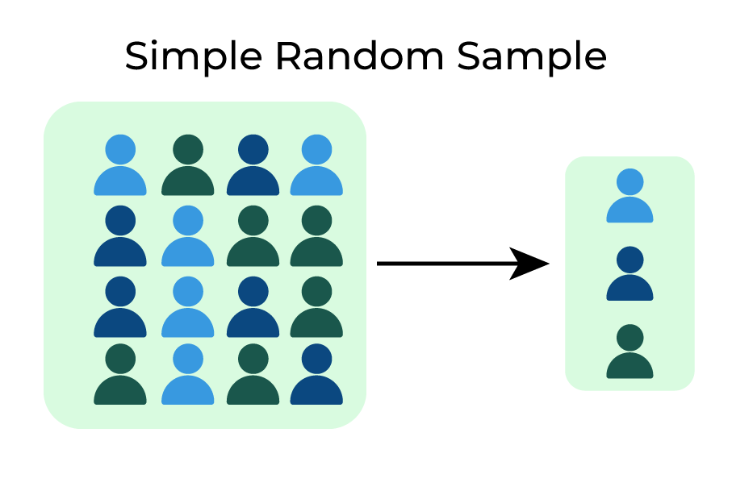
1
5

Slide 8
1
Stratified Random Sampling
This involves selecting a simple random sample from each of a given number of subpopulations. Each subpopulation is called a stratum (plural: strata),
5
Example:
If a study is taking senior citizens into consideration, the population may need to be subdivided into subgroups like 60-69 years old, 70-79 years old, etc. The sample will be chosen from each subgroups.

Slide 9
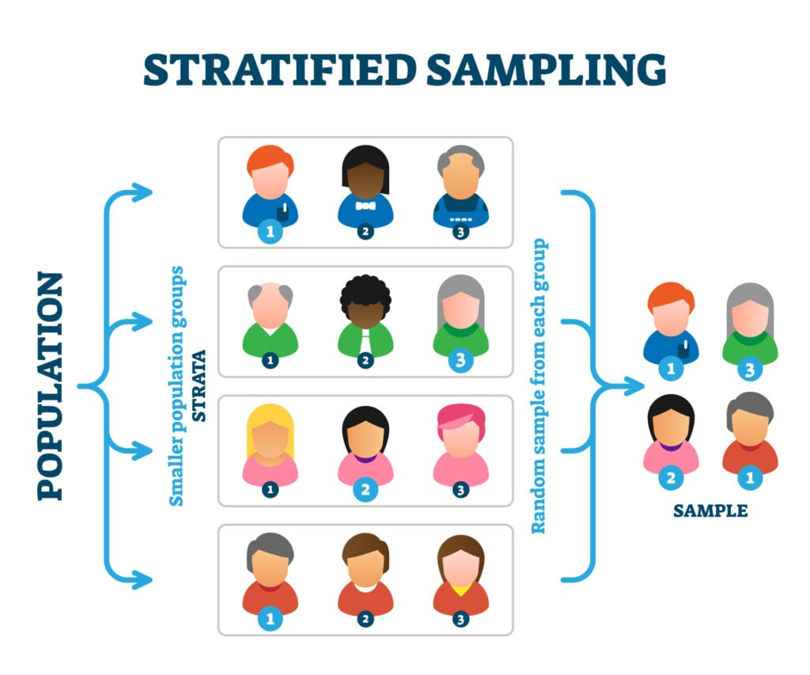
1
5

Slide 10
1
Cluster Sampling
The population is first divided into separate groups called clusters. Then, a simple random sample of clusters from the available clusters in the population is selected.
6
Example:
If the population is composed of all the senior citizens from Metro Manila, the clusters could be senior citizens from the different municipalities and cities in Metro Manila.
Data is then gathered from selected clusters, like 5 cities.

Slide 11
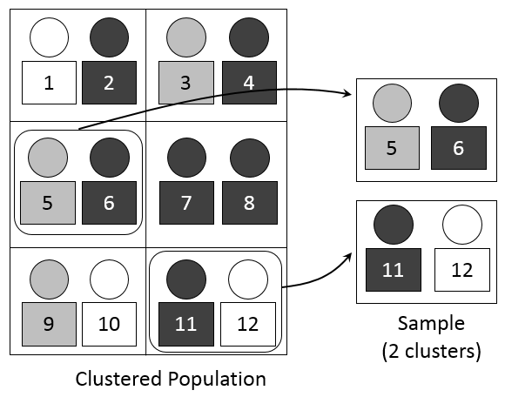
1
5

Slide 12
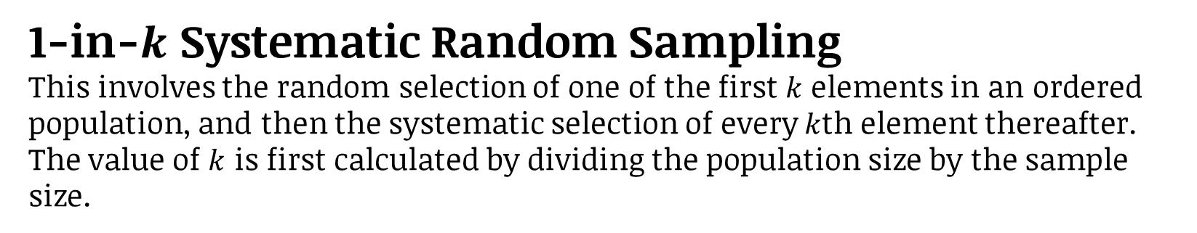
1
1-in-$k$ Systematic Random Sampling
This involves the random selection of one of the first $k$ elements in an ordered population, and then the systematic selection of every $k$th element thereafter.
The value of $k$ is first calculated by dividing the population size by the sample size.
7
Example:
Suppose there are 500 grade 5 students and you need to select 50 students as your sample.
Dividing the population size 500 by the sample size 50, we get 10. That means, every 10th student will be included in the sample.

Slide 13
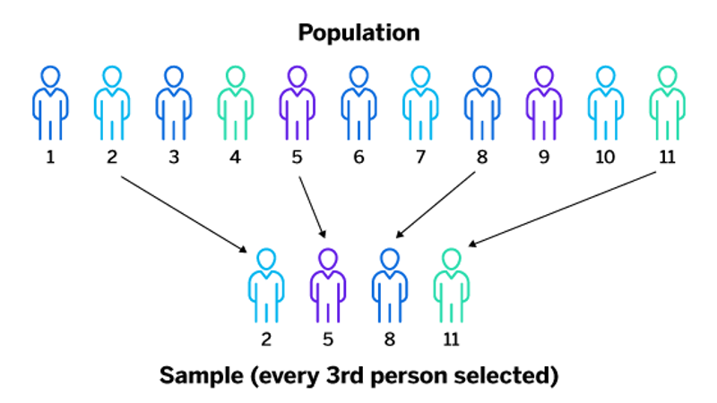
1
5

Slide 14
1
Multi-stage Sampling
Two or more probability techniques are combined. It can be described as sampling within the sample.
8
Example:
If the population is compose of all the senior citizens from Metro Manila, we can use clustered sampling where the clusters are the municipalities and cities in Metro manila.
Then from the selected clusters, we can use stratified sampling and divide into different age groups.

Slide 15
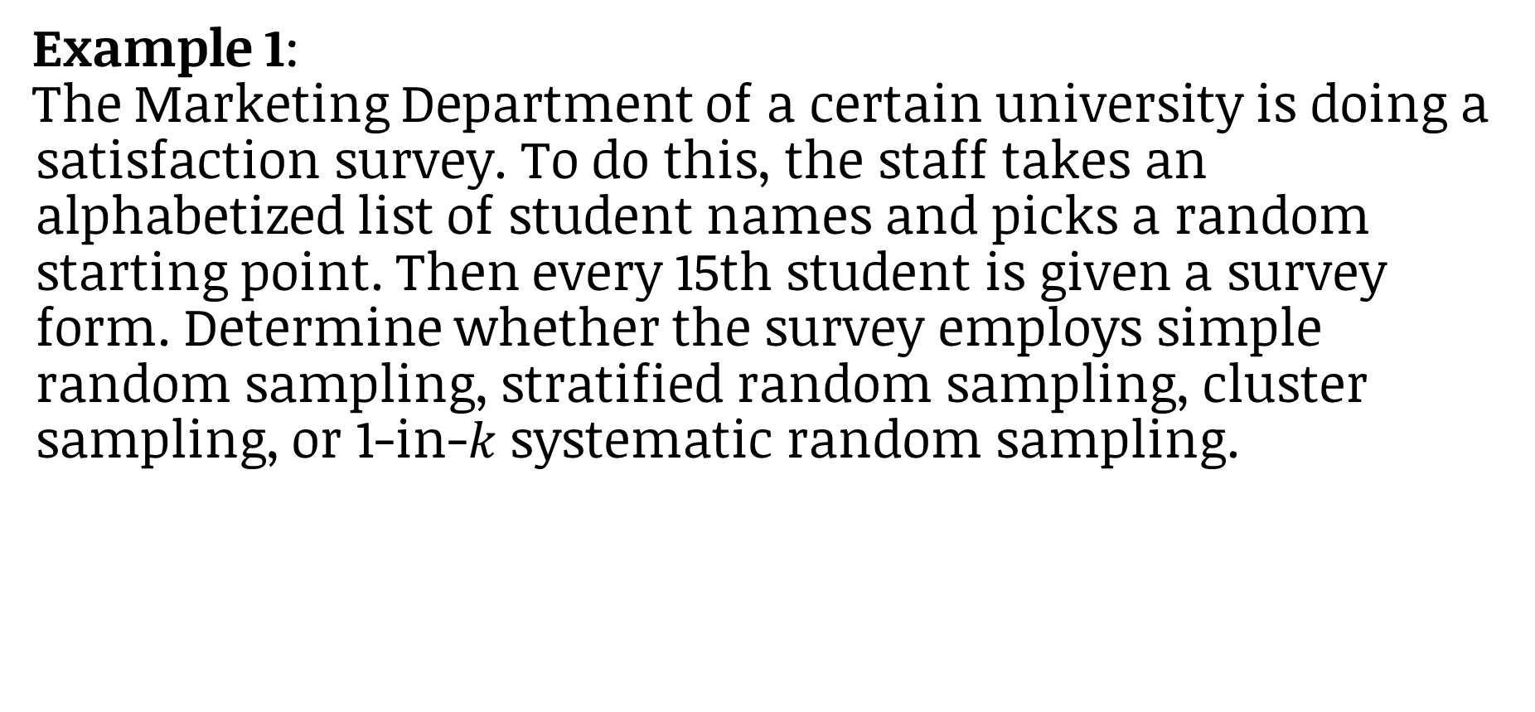
Example 1:
The Marketing Department of a certain university is doing a satisfaction survey. To do this, the staff takes an alphabetized list of student names and picks a random starting point. Then every 15th student is given a survey form. Determine whether the survey employs simple random sampling, stratified random sampling, cluster sampling, or 1-in-$k$ systematic random sampling.

Slide 16
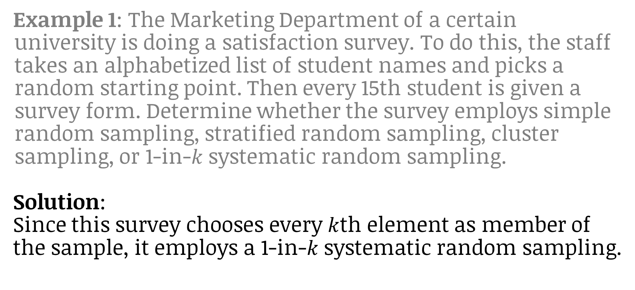
Example 1: The Marketing Department of a certain university is doing a satisfaction survey. To do this, the staff takes an alphabetized list of student names and picks a random starting point. Then every 15th student is given a survey form. Determine whether the survey employs simple random sampling, stratified random sampling, cluster sampling, or 1-in-$k$ systematic random sampling.
Solution:
Since this survey chooses every $k$th element as member of the sample, it employs a 1-in-$k$ systematic random sampling.

Slide 17
1
Non-Probability Sampling
The sampling techniques that do not involve random selection of data.
9
Different Types of Non-Probability Sampling:
Convenience Sampling
Snowball Sampling
Quota Sampling
Volunteer Sampling

Slide 18
1
Convenience Sampling
Wherein the researcher gathers data from nearby sources of information exerting minimal effort. Convenience is being used by persons giving questionnaires on the streets to ask the passersby.
10

Slide 19
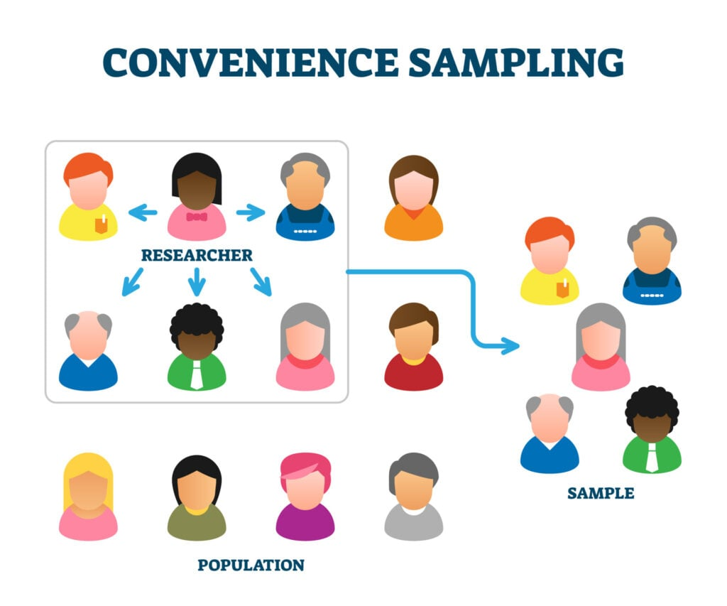
1
5

Slide 20
1
Snowball Sampling
or chain-referral sampling in which the samples have traits that are rare to find. This is a sampling technique, in which existing subjects provide referrals to recruit samples required for a research study.
11

Slide 21
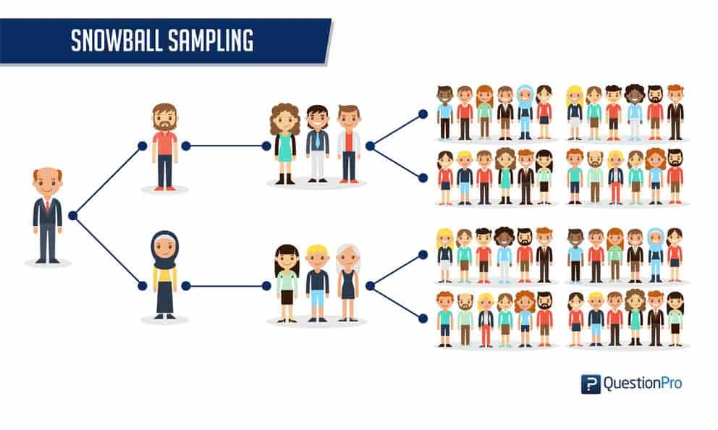
1
5

Slide 22
1
Quota Sampling
Sample units are picked for convenience but certain quotas are given to interviewers. This design is specially used in market research. Researchers choose these individuals according to specific traits or qualities.
12

Slide 23
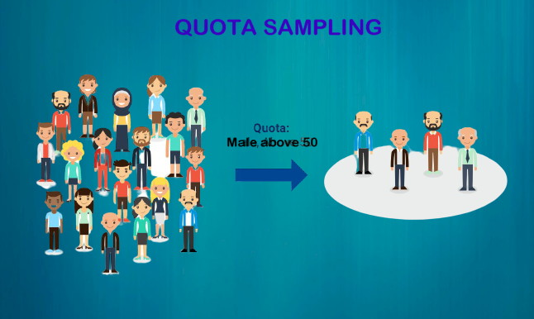
1
5

Slide 24
1
Volunteer Sampling
Sample units are volunteers in studies wherein the measuring process is painful or troublesome to a respondent.
13

Slide 25

1
5

Slide 26
Identify the type of sampling method. Write your answer on a 1/4 sheet of paper.
The teacher writes all the names of students in a piece of paper and puts it in a box for the graded recitation.
The teacher gets the class record and call every 4th name in the list.
Every five files out of 500 files will be chosen.
There are 20 toddlers, 40 teenagers, 45 middle aged and 55 senior citizens in a certain area. Samples are taken according to the total number of people in the area.
All the names of the employees of the company are put in a raffle box.

Slide 27
Parameter
Measurement or quantity that describes an entire population, which is the entire group you’re interested in studying.
1
14
Example:
All people living in one city, all-male teenagers worldwide, all elements in a shopping cart, and all students in a classroom.
The researcher interviewed all the students of a school for their favorite apparel brand.

Slide 28
Statistic
Measurement or quantity that describes only the sample, which is a smaller group taken from the population
1
15
Example:
Twenty-five out of the 100 randomly chosen grade 11 students belong to STEM strand.
Fifty percent of people living in the U.S. agree with the latest health care proposal. Researchers can’t ask hundreds of millions of people if they agree, so they take samples or part of the population and calculate the rest.

Slide 29
Example 2:
Suppose the quality manager wants to know the average life of the battery they manufacture. He asked his employees to obtain 100 random sample of batteries and test how long the batteries will last. From the sample, it was found out that the average life of the battery is 1 100 hours. Identify the parameter and statistic.

Slide 30
Example 2: Suppose the quality manager wants to know the average life of the battery they manufacture. He asked his employees to obtain 100 random sample of batteries and test how long the batteries will last. From the sample, it was found out that the average life of the battery is 1100 hours. Identify the parameter and statistic.
Solution:
In the study, 100 batteries are chosen as sample and it was found out that the average life is 1 100 hours.

Slide 31
Example 2: Suppose the quality manager wants to know the average life of the battery they manufacture. He asked his employees to obtain 100 random sample of batteries and test how long the batteries will last. From the sample, it was found out that the average life of the battery is 1100 hours. Identify the parameter and statistic.
Solution:
The statistic describes the sample. Therefore, 1 100 hours is the statistic in the study.

Slide 32
Example 2: Suppose the quality manager wants to know the average life of the battery they manufacture. He asked his employees to obtain 100 random sample of batteries and test how long the batteries will last. From the sample, it was found out that the average life of the battery is 1100 hours. Identify the parameter and statistic.
Solution:
The parameter is the average life of the battery they manufacture.

Slide 33
Decide whether the statement describes a parameter or statistic. Write your answer on a separate sheet of paper.
The average income of 40 out of 100 households in a certain Barangay is P 12, 213.00 a month.
Percentage of red cars in the Philippines.
Number of senior high schools in Region 3.
A recent survey of a sample of 250 high school students reported the average weight of 54.3 kg.
Average age of students in East High School.

Slide 34
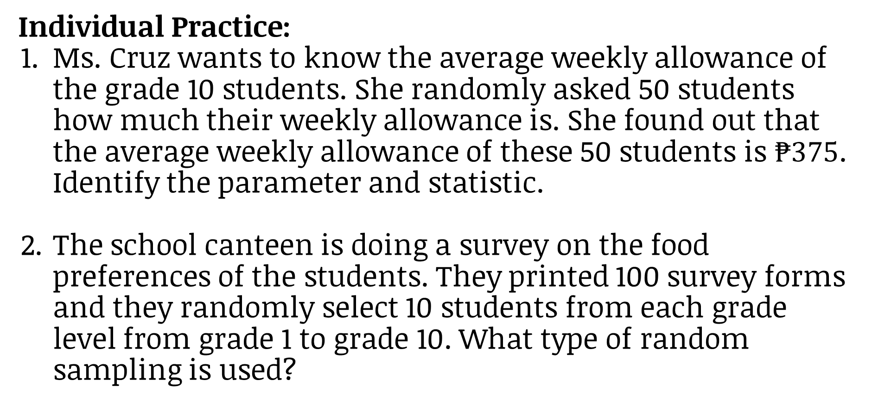
Individual Practice:
Ms. Cruz wants to know the average weekly allowance of the grade 10 students. She randomly asked 50 students how much their weekly allowance is. She found out that the average weekly allowance of these 50 students is $₱375$. Identify the parameter and statistic.
The school canteen is doing a survey on the food preferences of the students. They printed 100 survey forms and they randomly select 10 students from each grade level from grade 1 to grade 10. What type of random sampling is used?

Slide 35
Group Practice: To be done by 2-5 groups
A statistical company was commissioned to do a survey on which TV network is most preferred by the viewers in Metro Manila by age group. What type of sampling method can be used? Explain.

Slide 36
A. Determine whether the underlined numerical value or word is a parameter, statistic, population, or sample. (8 points)
The average charging time of a certain phone brand is 1 hour.
The median score of the class is 80.
Ten out of 30 students were surveyed on their favorite brand of toothpaste.
Forty boxes of battery were selected and tested for any defect.
The highest grade among the graduates of a certain university is 1.009.
The average height of 100 randomly selected students of the school is 165 cm.
The average daily wage of the employees of certain company is ₱585.
The lowest score among the 20 randomly selected scores is 5 points.

Slide 37
B. Identify the sampling method used in the following. Write your answer on the space provided. (8 points)
All the toys from 10 of the 50 boxes of toys were inspected for any defect.
Five male and 5 female students were selected from the class to be sample.
The teacher arranged the names of her students in alphabetical order then randomly select the starting name, and every 3rd student from the list is asked for their score.
The teacher assigned numbers 1-25 to her class of 25 students then generate 5 numbers from the computer.

Slide 38
C. Identify the population, sample, parameter, and statistic in the given situation. (4 points)
According to a previous survey, the average time spent by the college students studying at home every day is 40 minutes. To verify this, a researcher randomly selected 100 college students from a certain university and asked how long they spend studying at home every day. Then she calculated the average.
population: ___________________________________
sample: ______________________________________
parameter: ___________________________________
statistic: _____________________________________

Slide 39
1
Population
A group where members have something in common, that is, the total set of observations that can be made
1
2
Sample
a smaller group or subset of the population in question
3
Parameter
describes an entire population
4
Statistic
describes only the sample

Slide 40
1
Simple Random Sampling/Lottery Sampling
The simplest way of getting random sample where each member of the population has an equal chance of being chosen as the sample.
5
1
Stratified Random Sampling
This involves selecting a simple random sample from each of a given number of subpopulations. Each subpopulation is called a stratum (plural: strata),
6
7
Cluster Sampling
The population is first divided into separate groups called clusters. Then, a simple random sample of clusters from the available clusters in the population is selected.

Slide 41
1
1-in-$k$ Systematic Random Sampling
This involves the random selection of one of the first $k$ elements in an ordered population, and then the systematic selection of every $k$th element thereafter.
The value of $k$ is first calculated by dividing the population size by the sample size.
8
1
Multistage Sampling
Two or more probability techniques are combined. It can be described as sampling within the sample.
9

Slide 42
10
Non-Probability Sampling
The sampling techniques that do not involve random selection of data.
1
Convenience Sampling
Wherein the researcher gathers data from nearby sources of information exerting minimal effort.
11
Snowball Sampling
or chain-referral sampling in which the existing subjects provide referrals to recruit samples required for a research study.
12
Quota Sampling
Sample units are picked for convenience but certain quotas are given to interviewers.
13

Slide 43
Volunteer Sampling
Sample units are volunteers in studies wherein the measuring process is painful or troublesome to a respondent.
14
1
1

Slide 44
Sampling Distribution of Sample Means
A sampling distribution of sample mean is a frequency distribution using
the means computed from all possible random samples of a specific size
taken from a population. The means of the samples are less than or greater than the mean of the population.
1
16
Sampling Error
The difference between the sample means and the population.
17

Slide 45

Steps in Constructing the Sampling Distribution of the Means
Determine the number of sets of all possible random samples that can be drawn from the given population by using the formula,$b_{N}C_{n}$, where N is the population size and n is the sample size.
List all the possible samples and compute the mean of each sample.
Construct the sampling distribution.
1
18

Slide 46

Example 1. A population consists of the five numbers 2, 3, 6, 10 and 12. Consider samples of size 2 that can be drawn from this population.
Determine the number of sets of all possible random samples that can be drawn from the given population by using the formula, $b_{N}C_{n}$, where N is the population size and n is the sample size.
In this case N= 5 and n= 2
$b_{N}C_{n}=\frac{N!}{n!(N−n)!}$ or $b_{5}C_{2}$= 10
So, there are 10 possible samples to be drawn.

Slide 47
2. List all the possible samples and compute the mean of each sample. 2 3 6 10 12
Sample | Mean
2, 3 | 2.5
2, 6 | 4
2, 10 | 6
2, 12 | 7
3, 6 | 4.5
3, 10 | 6.5
3, 12 | 7.5
6, 10 | 8
6, 12 | 9
10, 12 | 11

Slide 48
3. Construct the sampling table.
Sample Mean (x) | Frequency | Probability
2.5 | 1 | 1/10
4 | 1 | 1/10
4.5 | 1 | 1/10
6 | 1 | 1/10
6.5 | 1 | 1/10
7 | 1 | 1/10
7.5 | 1 | 1/10
8 | 1 | 1/10
9 | 1 | 1/10
11 | 1 | 1/10
Total | 10 | 1

Slide 49

Example 2. Construct a sampling distribution of sample mean for the set of data 86 88 90 95 98. Consider a sample size of 3 that can be drawn from a population.
Determine the number of sets of all possible random samples that can be drawn from the given population by using the formula, $b_{N}C_{n}$, where N is the population size and n is the sample size.
In this case N= 5 and n= 2
$b_{N}C_{n}=\frac{N!}{n!(N−n)!}$ or $b_{5}C_{3}$= 10
So, there are 10 possible samples to be drawn.

Slide 50
2. List all the possible samples and compute the mean of each sample. 86 88 90 95 98
Sample | Mean
86, 88, 90 | 88
86, 88, 95 | 89.67
86, 88, 98 | 90.67
86, 90, 95 | 90.33
86, 90, 98 | 91.33
86, 95, 98 | 93
88, 90, 95 | 91
88, 90, 98 | 92
88, 95, 98 | 93.67
90, 95, 98 | 94.33

Slide 51
3. Construct the sampling table.
Sample Mean (x) | Frequency | Probability
88 | 1 | 1/10
89.67 | 1 | 1/10
90.33 | 1 | 1/10
90.67 | 1 | 1/10
91 | 1 | 1/10
91.33 | 1 | 1/10
92 | 1 | 1/10
93 | 1 | 1/10
93.67 | 1 | 1/10
94.33 | 1 | 1/10
Total | 10 | 1

Slide 52
Example 3. John Mark receives 82 or 83 as his grade on his three major subjects. Construct the sampling of his mean grade.
List all the samples.
A | B | C
82 | 82 | 82
82 | 82 | 83
82 | 83 | 82
82 | 83 | 83
A | B | C
83 | 82 | 82
83 | 82 | 83
83 | 83 | 82
83 | 83 | 83

Slide 53
2. Compute the mean of each sample.
A | B | C | x
82 | 82 | 82 | 82
82 | 82 | 83 | 82.33
82 | 83 | 82 | 82.33
82 | 83 | 83 | 82.67
83 | 82 | 82 | 82.33
83 | 82 | 83 | 82.67
83 | 83 | 82 | 82.67
83 | 83 | 83 | 83

Slide 54
3. Construct the sampling distribution.
Sample Mean | Frequency | P(x)
82 | 1 | 1/8 = 0.125
82.33 | 3 | 3/8 = 0.375
82.67 | 3 | 3/8 = 0.375
83 | 1 | 1/8 = 0.125
Total | 8 | 1.00

Slide 55

Q1. What is the probability that his mean grade is lower than 83?
$P\left(X<83\right)=0.125+0.375+0.375$
$P\left(X<83\right)=0.875 or 87.5\%$
Sample Mean | Frequency | P(x)
82 | 1 | 1/8 = 0.125
82.33 | 3 | 3/8 = 0.375
82.67 | 3 | 3/8 = 0.375
83 | 1 | 1/8 = 0.125
Total | 8 | 1.00

Slide 56

Q2. What is the probability that his mean grade is grater than 82.33?
$P\left(X>82.33\right)=0.375+0.125$
$P\left(X>82.33\right)=0.5 or 50\%$
Sample Mean | Frequency | P(x)
82 | 1 | 1/8 = 0.125
82.33 | 3 | 3/8 = 0.375
82.67 | 3 | 3/8 = 0.375
83 | 1 | 1/8 = 0.125
Total | 8 | 1.00

Slide 57

Q3. What is the probability that his mean grade is 82.67?
$P\left(X=82.67\right)=0.375 or 37.5\%$
Sample Mean | Frequency | P(x)
82 | 1 | 1/8 = 0.125
82.33 | 3 | 3/8 = 0.375
82.67 | 3 | 3/8 = 0.375
83 | 1 | 1/8 = 0.125
Total | 8 | 1.00

Slide 58

Q4. What is the probability that his mean grade is between 82.33 and 83?
$P\left(82.33<X<83\right)=0.375 or 37.5\%$
Sample Mean | Frequency | P(x)
82 | 1 | 1/8 = 0.125
82.33 | 3 | 3/8 = 0.375
82.67 | 3 | 3/8 = 0.375
83 | 1 | 1/8 = 0.125
Total | 8 | 1.00

Slide 59
Construct a sampling distribution of sample mean and answer the questions on your answer sheet.
Samples of 3 cards are drawn from a population of five cards numbered from 1-5.
How many are the possible outcomes?
What are the possible means?
What is the probability of getting 4 as a mean?
What is the probability of getting 2 as a mean?
What is the probability of getting 3.33 as a mean?

